Slide 1
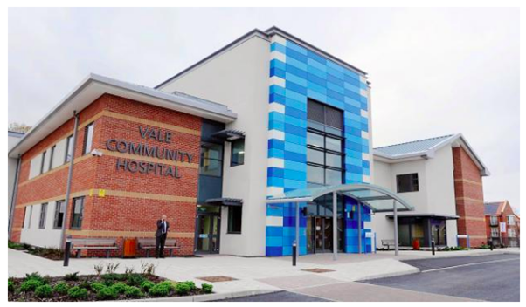



Presentation to IFIC Conference
Celebrating Care Closer to Home
Launching a New International Network of Community Hospitals
Dr David Seamark
President
Community Hospitals Association
Email – infocommunityhospitals@gmail.com Website – www.communityhospitals.org.uk
Notes:
It is an honour to speak at your conference today, thank you.
I represent the Community Hospitals Association and I am speaking on behalf of my colleagues. We have been having regular meetings and discussions with Professor Giovanni and his team, and finding it very beneficial to share ideas and experiences as well as evidence.
I hope that in this talk I will show what is happening with community hospitals in the UK, and the valuable contribution they make in our health services. I will also speak of how much patients and communities value their community hospitals.

Slide 2

Launch of International Network
Community Hospitals
IFIC Scotland Special Interest Group Intermediate Care will host the network in partnership with Community Hospitals Association https://integratedcarefoundation.org/sig_groups/intermediate-care
First Webinar had 263 people registered from 31 countries Community Hospitals - Integrated Care Matters Webinar Series 9 : Care at Home
https://integratedcarefoundation.org/events/community-hospitals-webinars-series-9-care-at-home
This is a perfect model for patient centred hands-on care and should be promoted

Slide 3
An Overview of CHA
500 Community Hospitals in the UK
Members in UK & Internationally
18 Committee Members
150 CHA Innovation and Best Practice Awards in 22 years
55 Years of the CHA

Slide 4




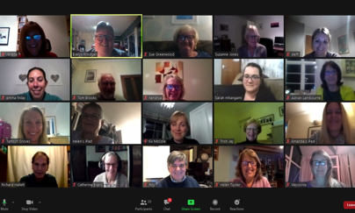
CHA Key Roles
Quality Improvement
Networking
Research

Slide 5
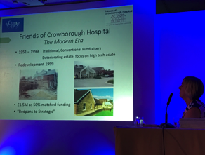

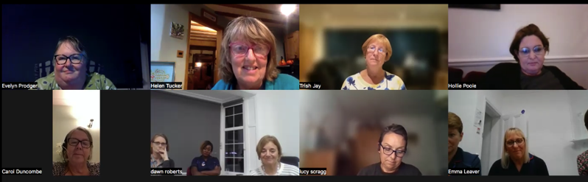

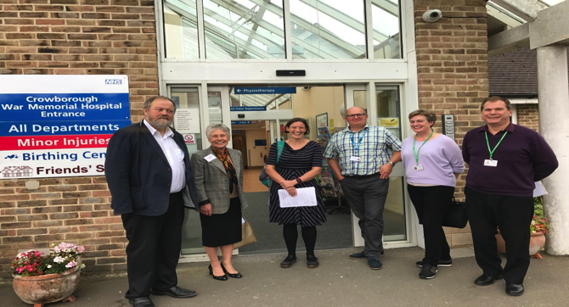

CHA Activities
Conferences
Newsletters
Online Discussion Groups
Visits to Community Hospitals
Website
Also Twitter, Facebook, Linkedin and other social media

Slide 6

Why have Community Hospitals?
Local access to services
Meeting needs in predominantly remote rural and coastal areas
Local facilities
Local staff
Provide care not requiring a General Hospital
Service that is familiar and small in scale
A Centre for the whole community

Slide 7
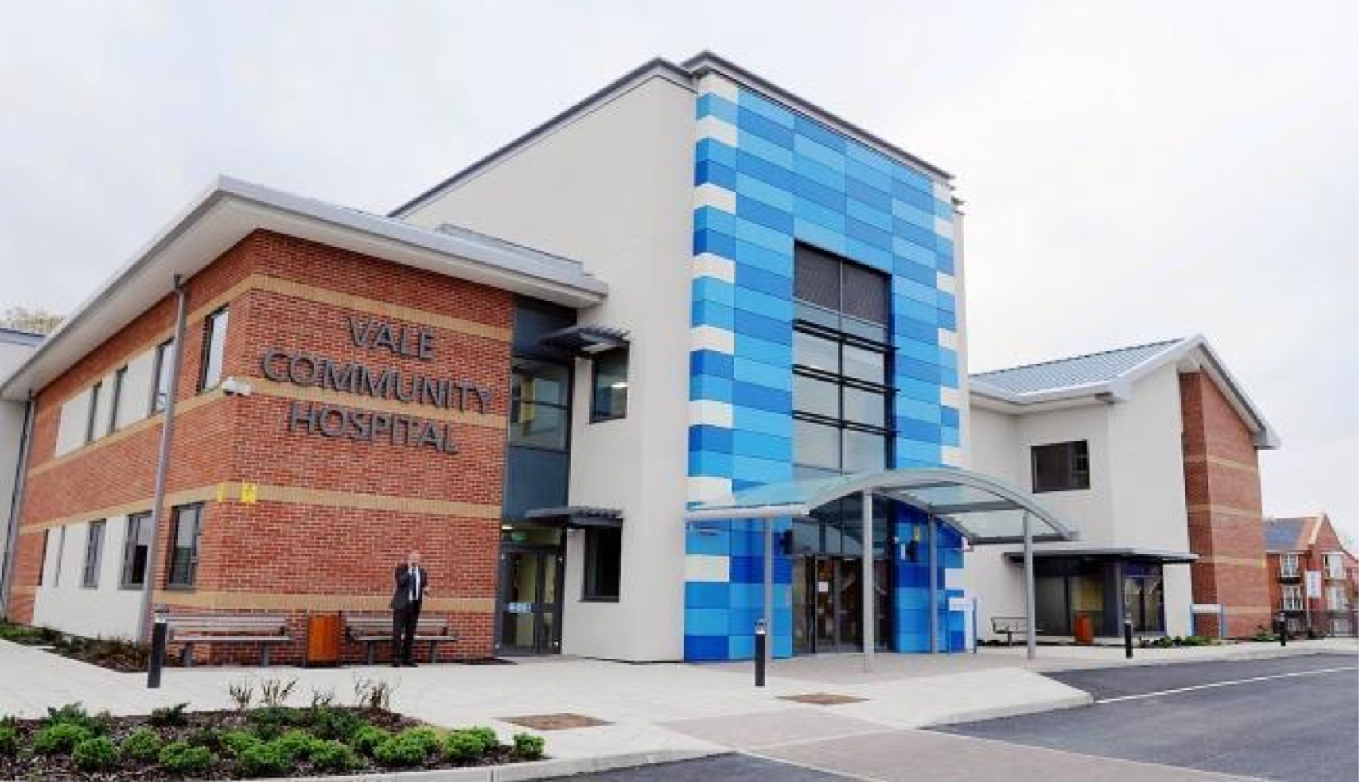
A Typical Community Hospital
Small local hospital
Rural
Serving a local community
Nurse-led
Multi-disciplinary Teams
Extended Primary Care
Intermediate Care
The Vale Hospital, Gloucestershire, England
Notes:
Small local – usually 1 ward or 2 – av 20 beds
Remote and rural – not near a General hospital
Serves a defined community – meeting local needs
Nurse or therapy-led – no medical staff on site
Extended primary care – generalist intermediate care

Slide 8
Role of Community Hospitals – Care Closer to Home
Intermediate care
Acute and sub-acute care - avoiding an acute hospital admission avoidance and support post-acute discharge
End of Life & Palliative Care
Providing a range of services
Rehabilitation
Support patients to optimise independence and provide local discharge planning
Pitchforth E, Nolte E, Corbett J, et al. Community hospitals and their services in the NHS: identifying transferable learning from international developments – scoping review, systematic review, country reports and case studies. Southampton (UK): NIHR Journals Library; 2017 Jun. (: https://www.ncbi.nlm.nih.gov/books/NBK436700/

Slide 9
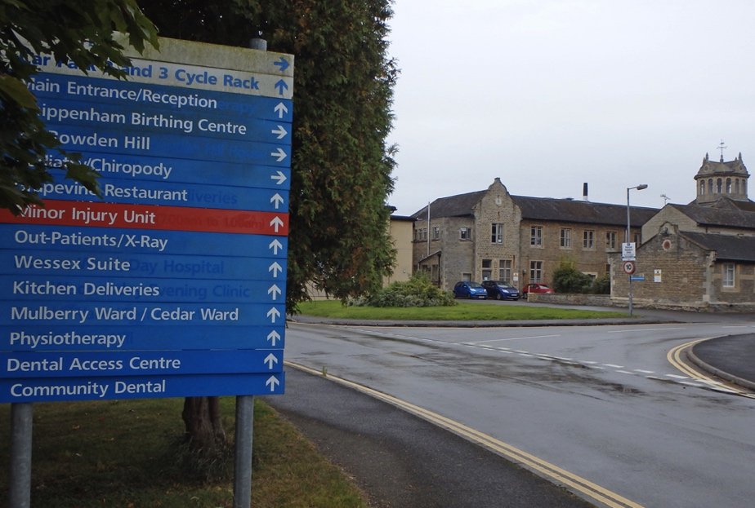
Services in community hospitals
Inpatient Beds
Outpatient Clinics
Urgent Care
Diagnostics & Treatment
Therapies
Health Promotion
And others….

Slide 10
Models of Community Hospitals in UK
Community Hospital
Classic community hospital with beds and community services – typically in rural areas
Community Ward in a General Hospital
Nurse-led ward for generalist not specialist care – rehabilitation and sub-acute – typically in urban areas
Intermediate Care/Rehabilitation Facility
Post- discharge patients from General Hospital, focus on supporting patients to go home
Community Health and Wellbeing Centre
A Centre for health, social care, health promotion and welfare. Was a community hospital – now no beds.

Slide 11
Types of Integration in Community Hospitals
Multidisciplinary
Health and Social Care
Community Hospital and Secondary Care
Community Hospital and Primary Care
Community Hospital and Local Community

Slide 12

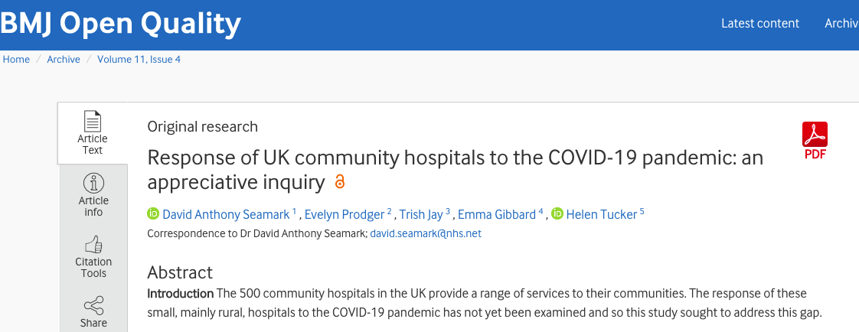
Evidence
On CHA website
Research evidence
https://www.communityhospitals.org.uk/quality-improvement/recent-papers-publications.html
Study on Community Hospitals During COVID-19
http://www.communityhospitals.org.uk/quality-improvement/reports.html

Slide 13

Features of Community Hospitals
From CHA COVID-19 Study
Flexible
Resilient
Integrated
Responsive
Creative
Compassionate
CHA COVID-19 Study Funded by Q Exchange, Health Foundation

Slide 14
Thank you
Join our New International Network
Email: Marie Curan IFICScotland@integratedcarefoundation.org

